Slide 1
MOCK PROJECT
Implementer: Lê Minh Huy
Class Code: HCM23_FRF_EMB_12

Slide 2
MAIN MENU
Requirements
Planning
Design
Programming
Testing
User Guide Documentation

Slide 3
Requirements
Write a number guesting game as following descriptions - User could enter their name when starting program - For each round, the program generates randomly a magic number which has 4 digits. - The user guests and enter 1 number each time. If there are matched number, the program prints out the result and the magic number (which guested number in correct position, the remaining are '-') - Whenever the player could explore the magic number, print out their lucky ratio correct guess total guess Print out the lucky ratio history of the program, with 5 highest player.

Slide 4
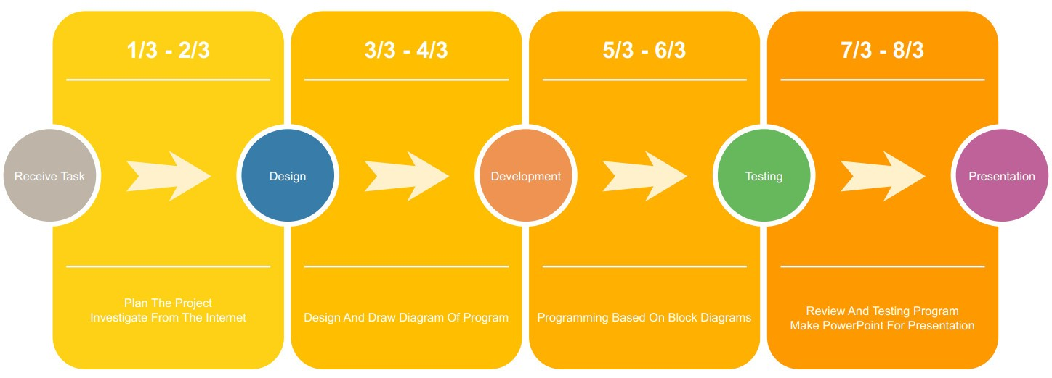
Planning

Slide 5
Design
Flow Chart
Sequence Diagram

Slide 6
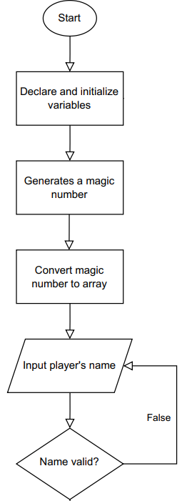
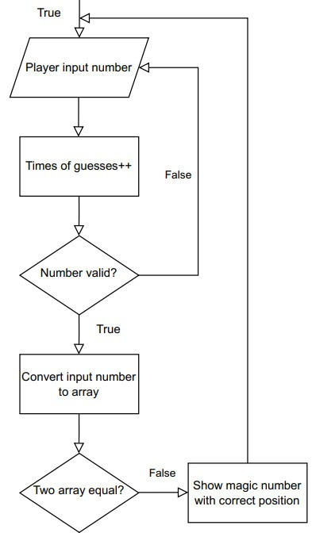
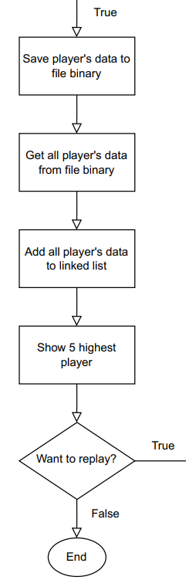
Flow Chart
Replay:
Replay:

Slide 7
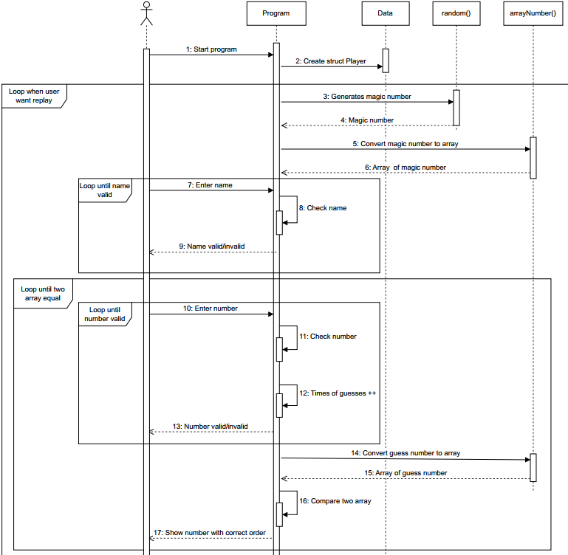
Sequence Diagram

Slide 8
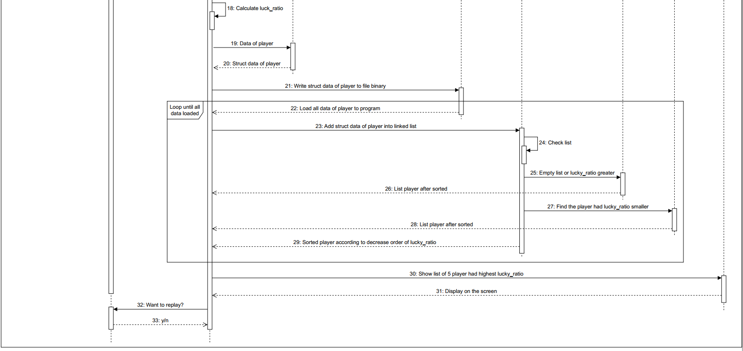
Sequence Diagram
Data
Player
List_Player.bin
insertSorted()
Program
insertBeginList()
insertAfter()
printList()

Slide 9
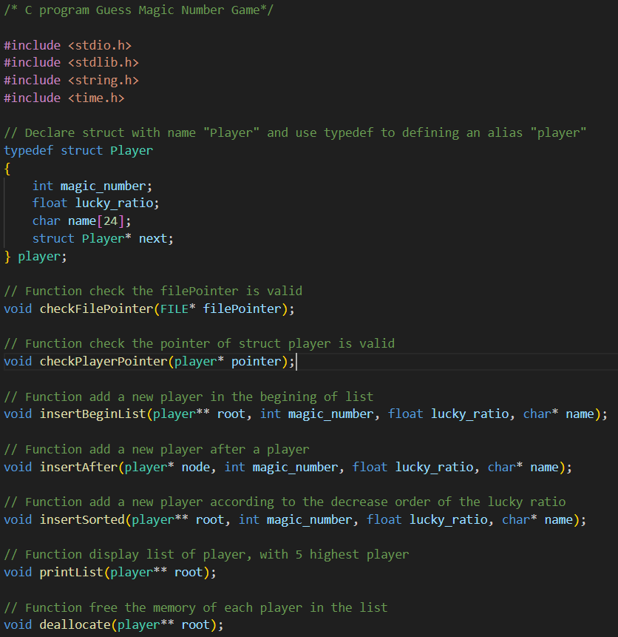
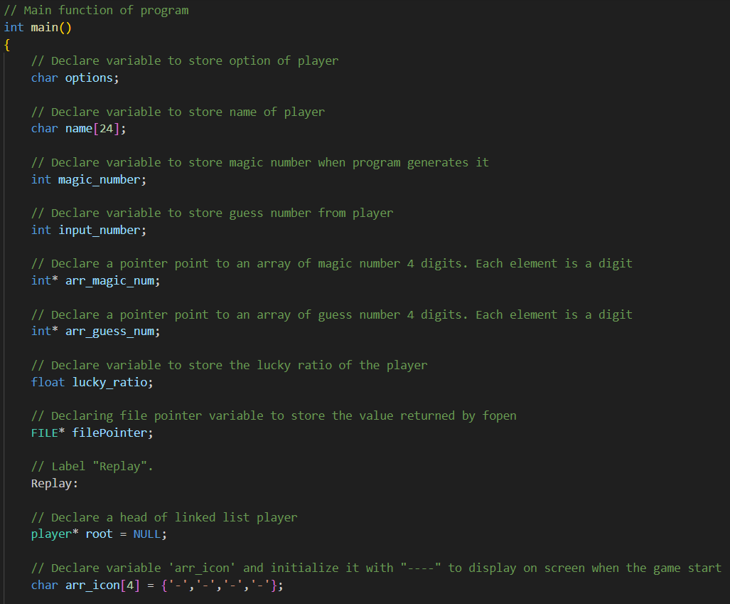
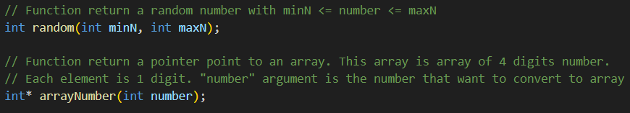
Programming

Slide 10
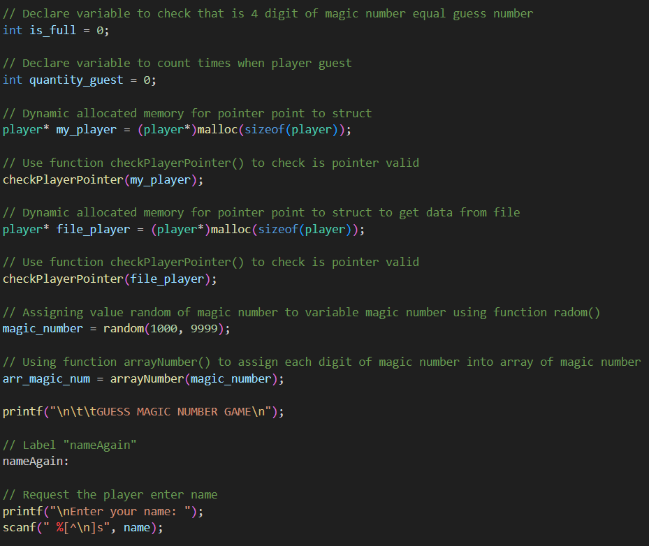
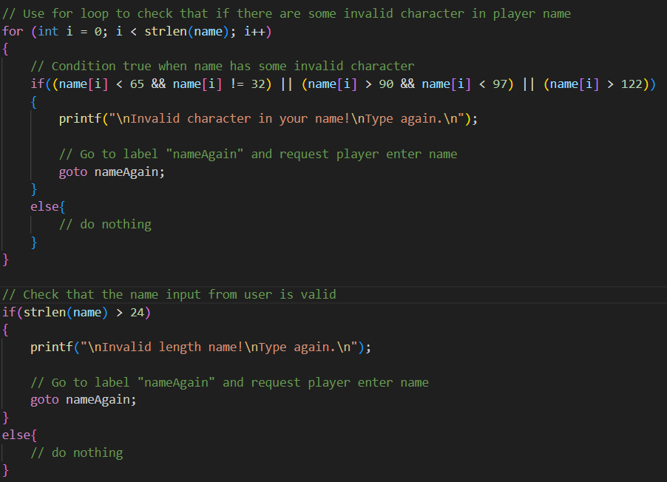
Programming

Slide 11
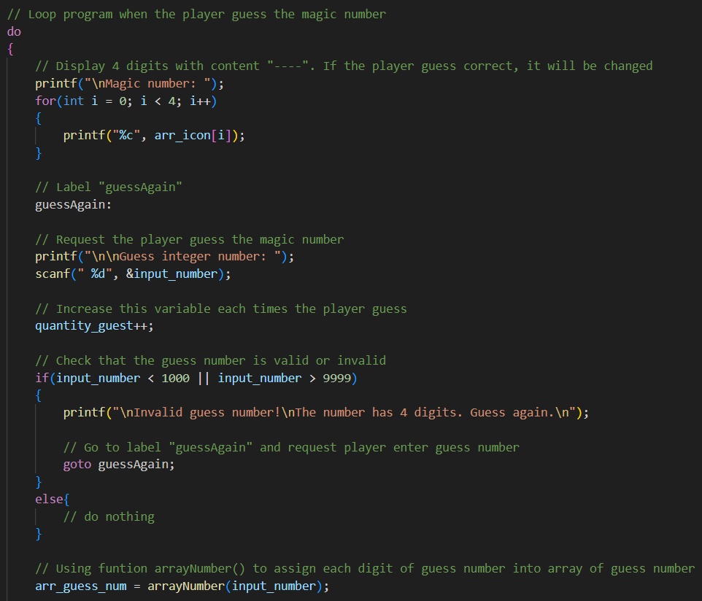
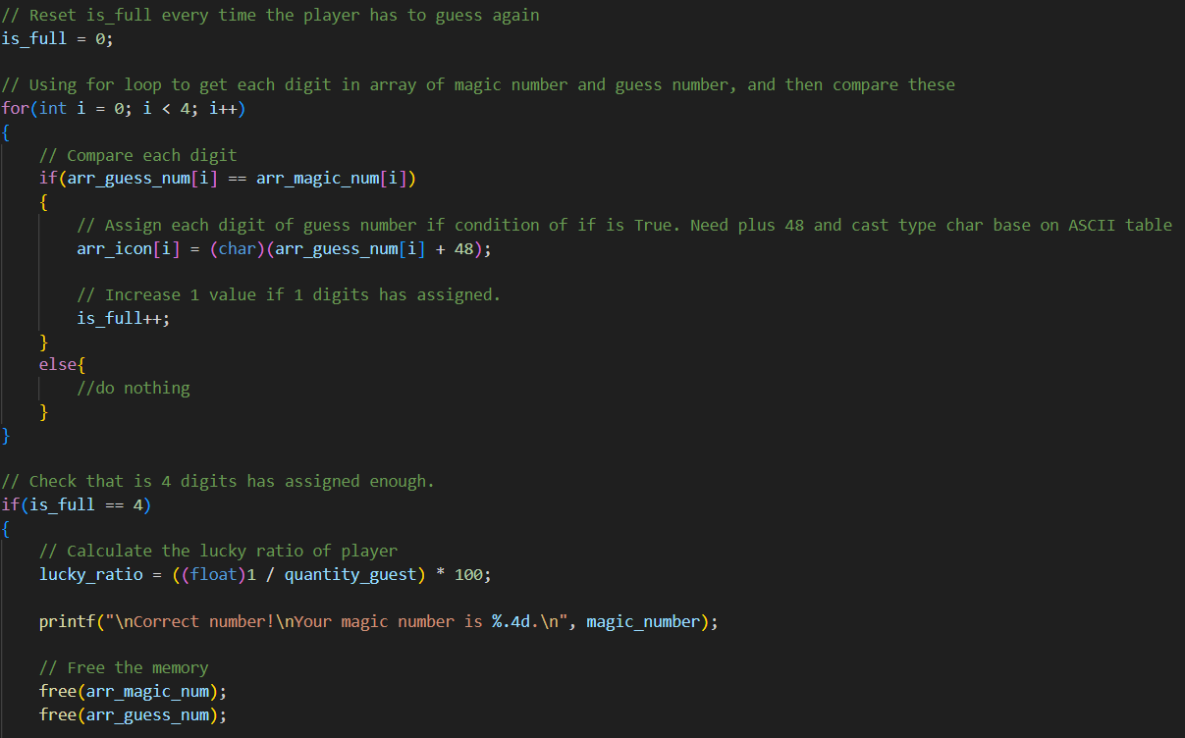
Programming

Slide 12
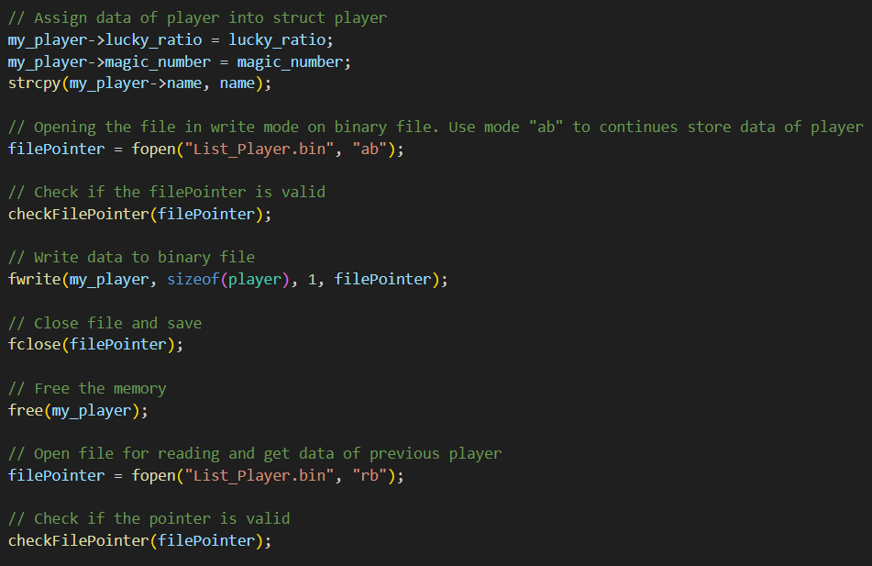
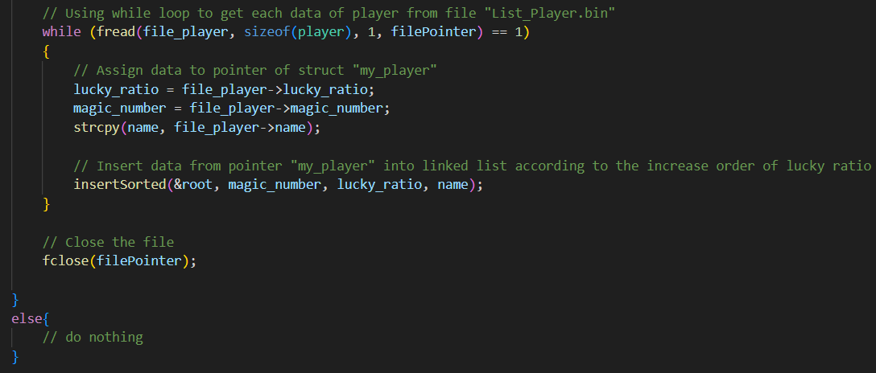
Programming

Slide 13
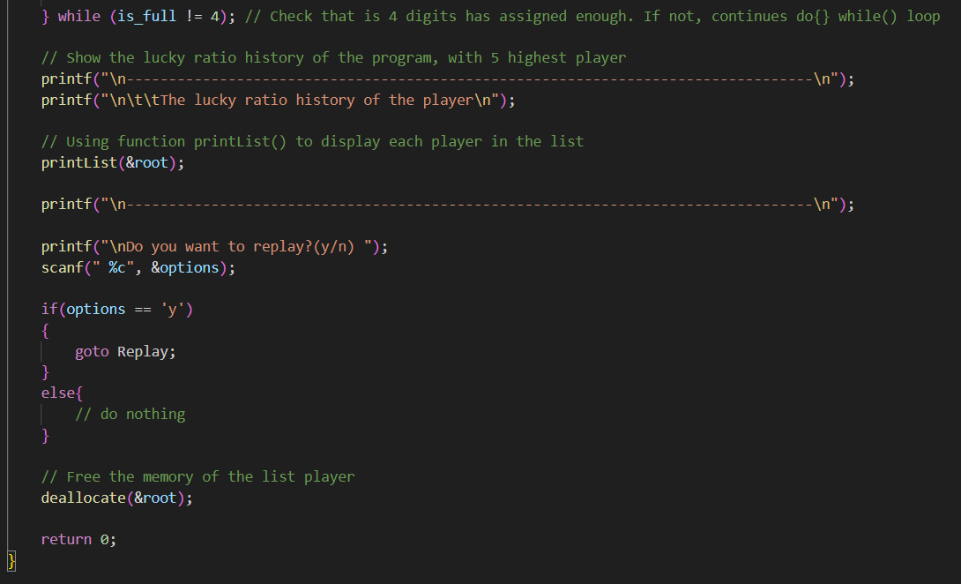
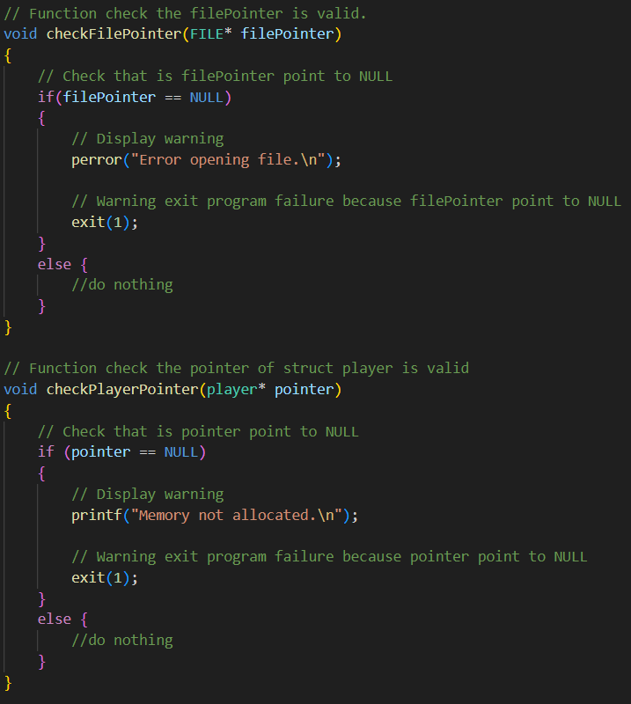
Programming

Slide 14
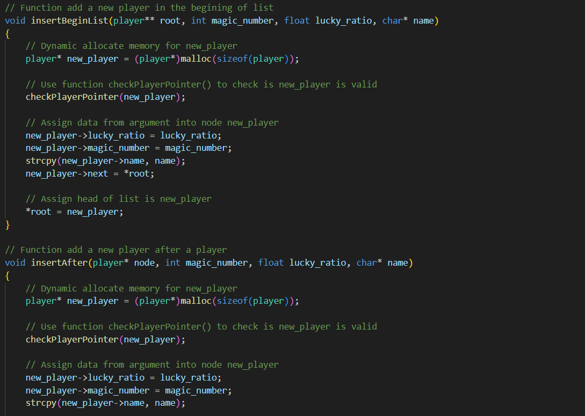
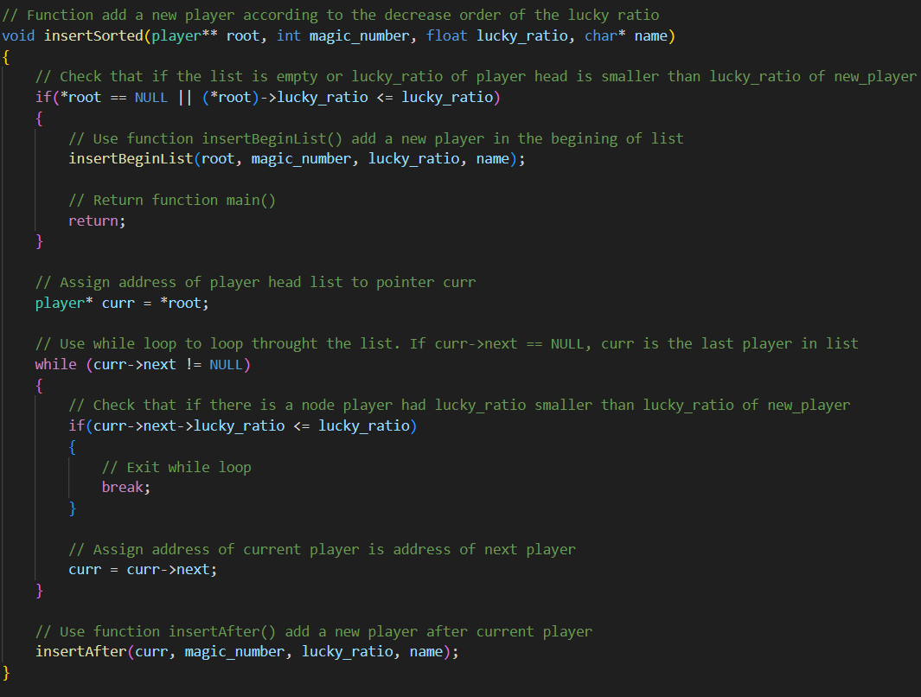
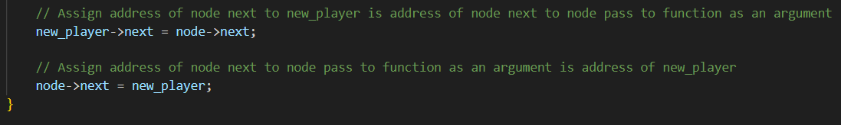
Programming

Slide 15
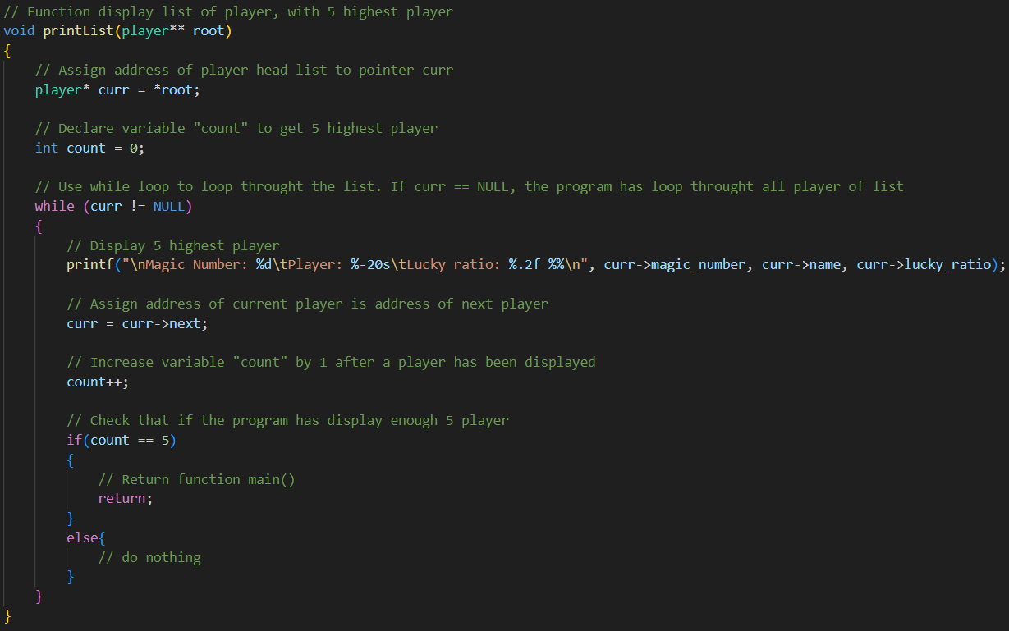
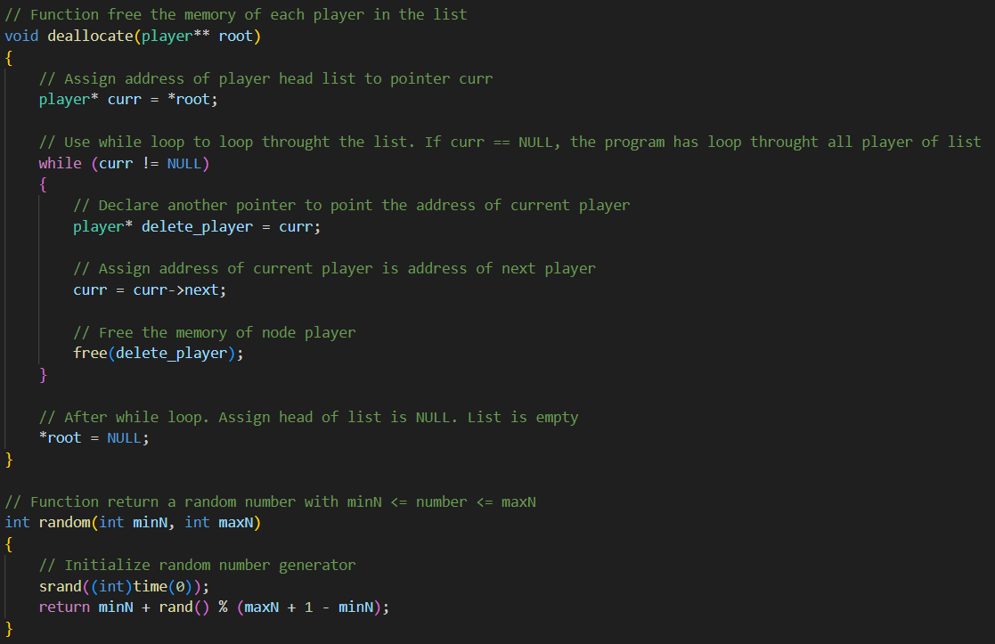
Programming

Slide 16
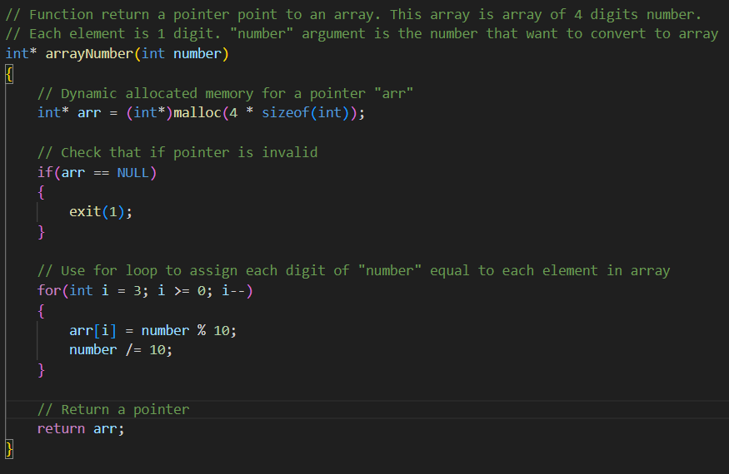
Programming

Slide 17
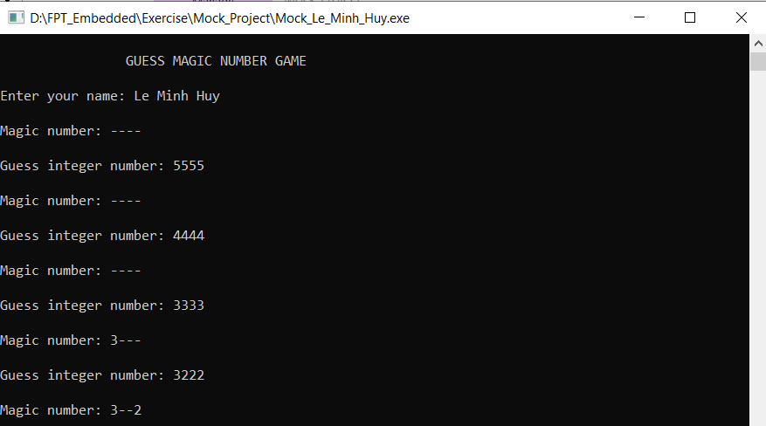
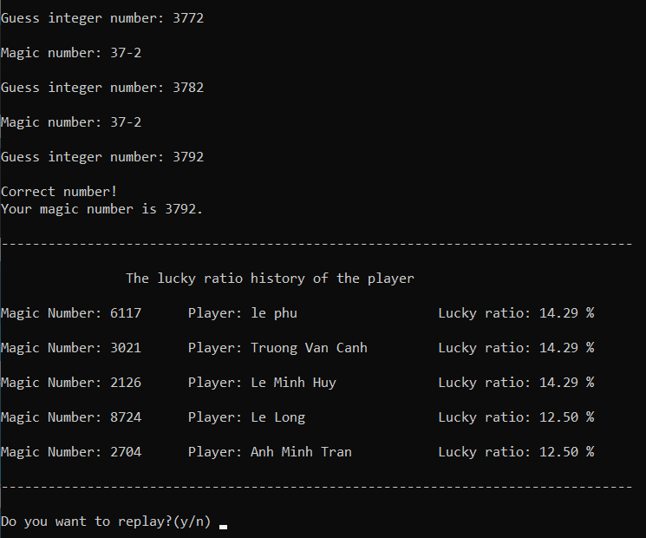
Testing

Slide 18
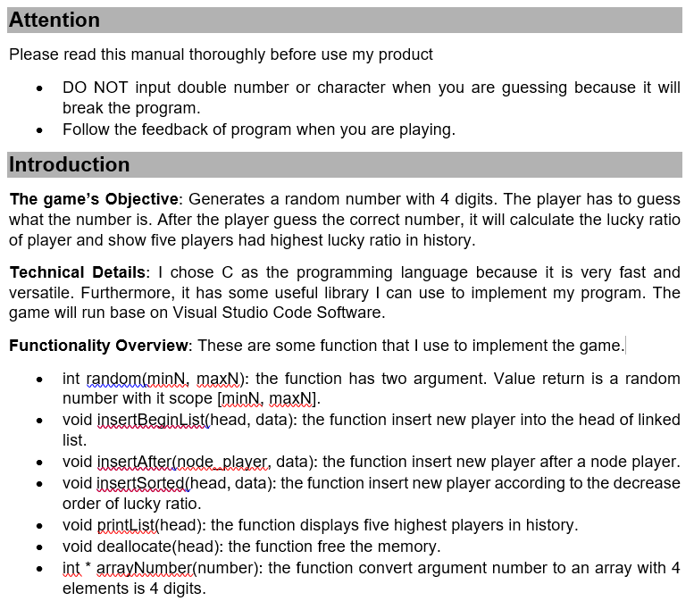
User Guide Documentation

Slide 19
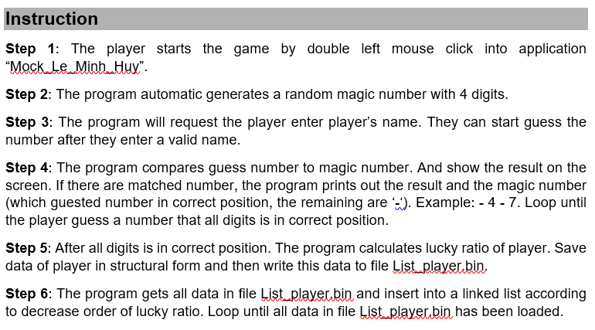
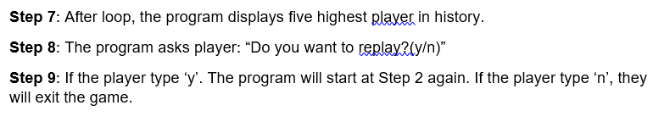
User Guide Documentation

Slide 20


